Slide 1
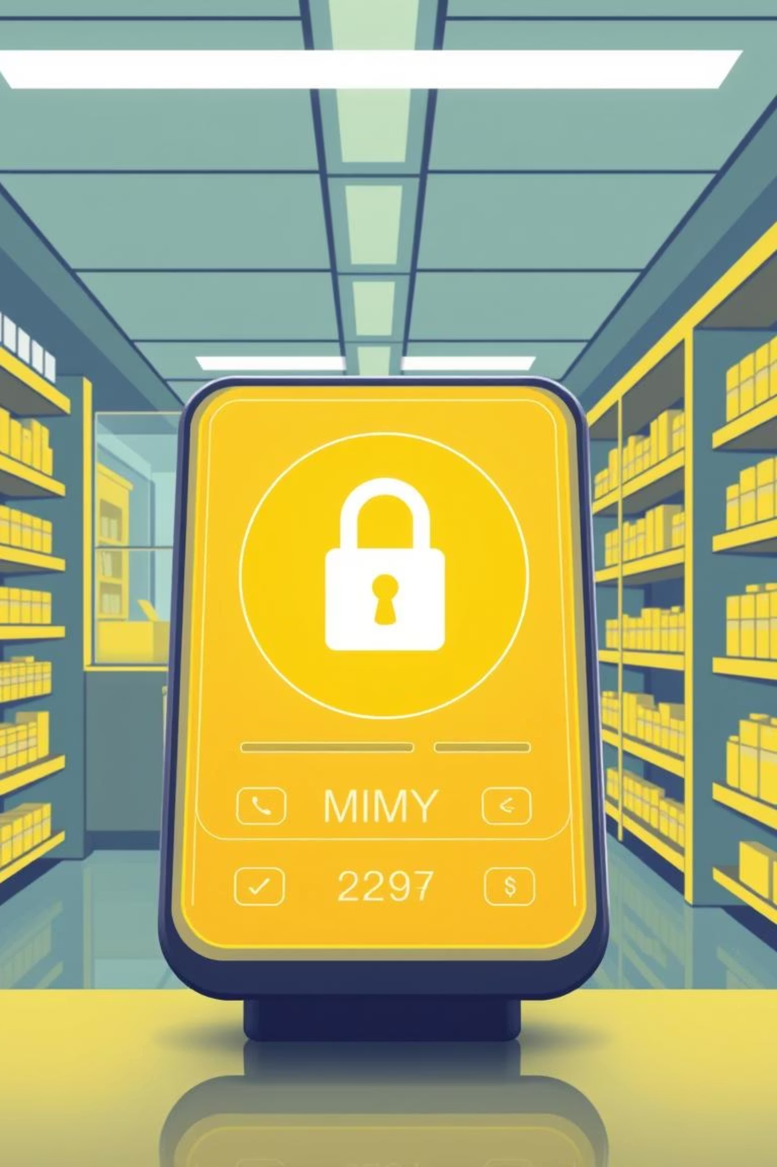
Smart Prescription Fraud Prevention & Real-Time Verification System
Presented by: Niyomugabo Nice Kevin
Date: November 17, 2025

Slide 2


Project Overview: Safeguarding Prescriptions
Detect & Prevent Fraud
Utilizing PL/SQL to combat forged or altered prescriptions in real-time.
Enhance Patient Safety
Ensuring medicine compliance and protecting patients from drug misuse.
Real-Time Monitoring
Integrated monitoring, alerts, and audit logging for comprehensive oversight.
Secure Audit Trails
Maintaining tamper-proof records for accountability and compliance.

Slide 3
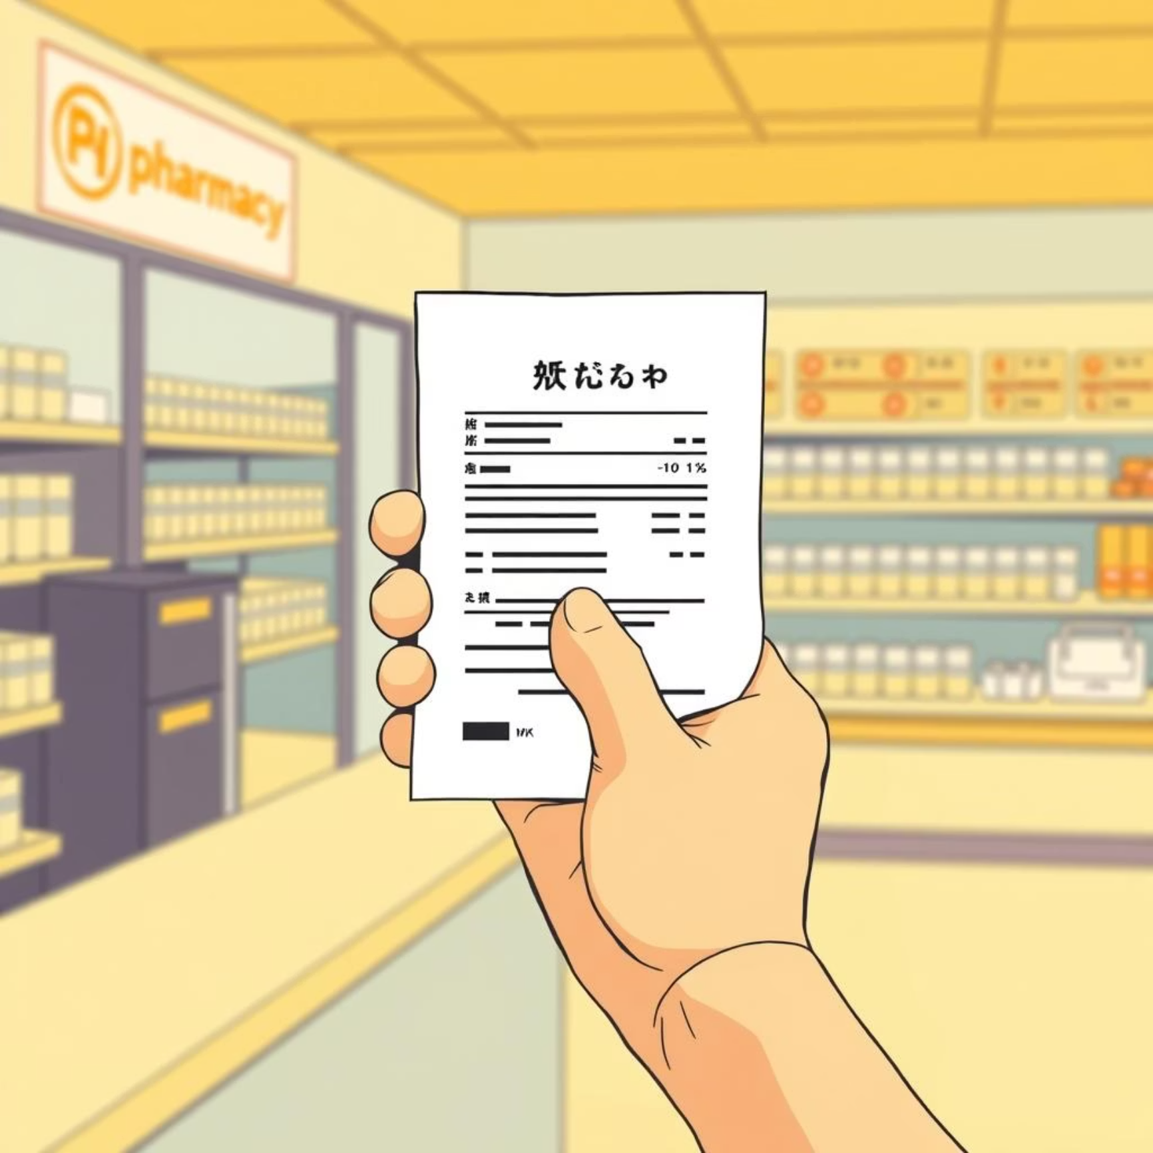
Addressing Critical Challenges in Prescription Management
The Problem Defined:
Increasing cases of forged or altered prescriptions.
Unauthorized refill requests and doctor impersonation.
Slow, error-prone manual verification processes.
Absence of secure audit trails for regulatory compliance.
Impact if Unsolved:
Significant financial losses for healthcare facilities.
Elevated risk of drug misuse and abuse.
Compromised patient safety and treatment efficacy.
Our Solution:
Automatically detect and prevent suspicious prescription activities using advanced PL/SQL logic, securing the entire dispensing process.

Slide 4

System Context & Key Users
System Application:
Seamlessly integrated into hospitals, clinics, and pharmacies.
Monitors prescriptions in real-time, generating immediate alerts for suspicious activities.
Powered by Oracle Database, leveraging robust PL/SQL triggers, procedures, and functions.
Target Audience:
Primary Users:
Pharmacists
Hospital IT Staff
Prescription Verification Officers
Doctors
Secondary Users:
Hospital Administrators
Health Regulators
Insurance Fraud Investigators

Slide 5
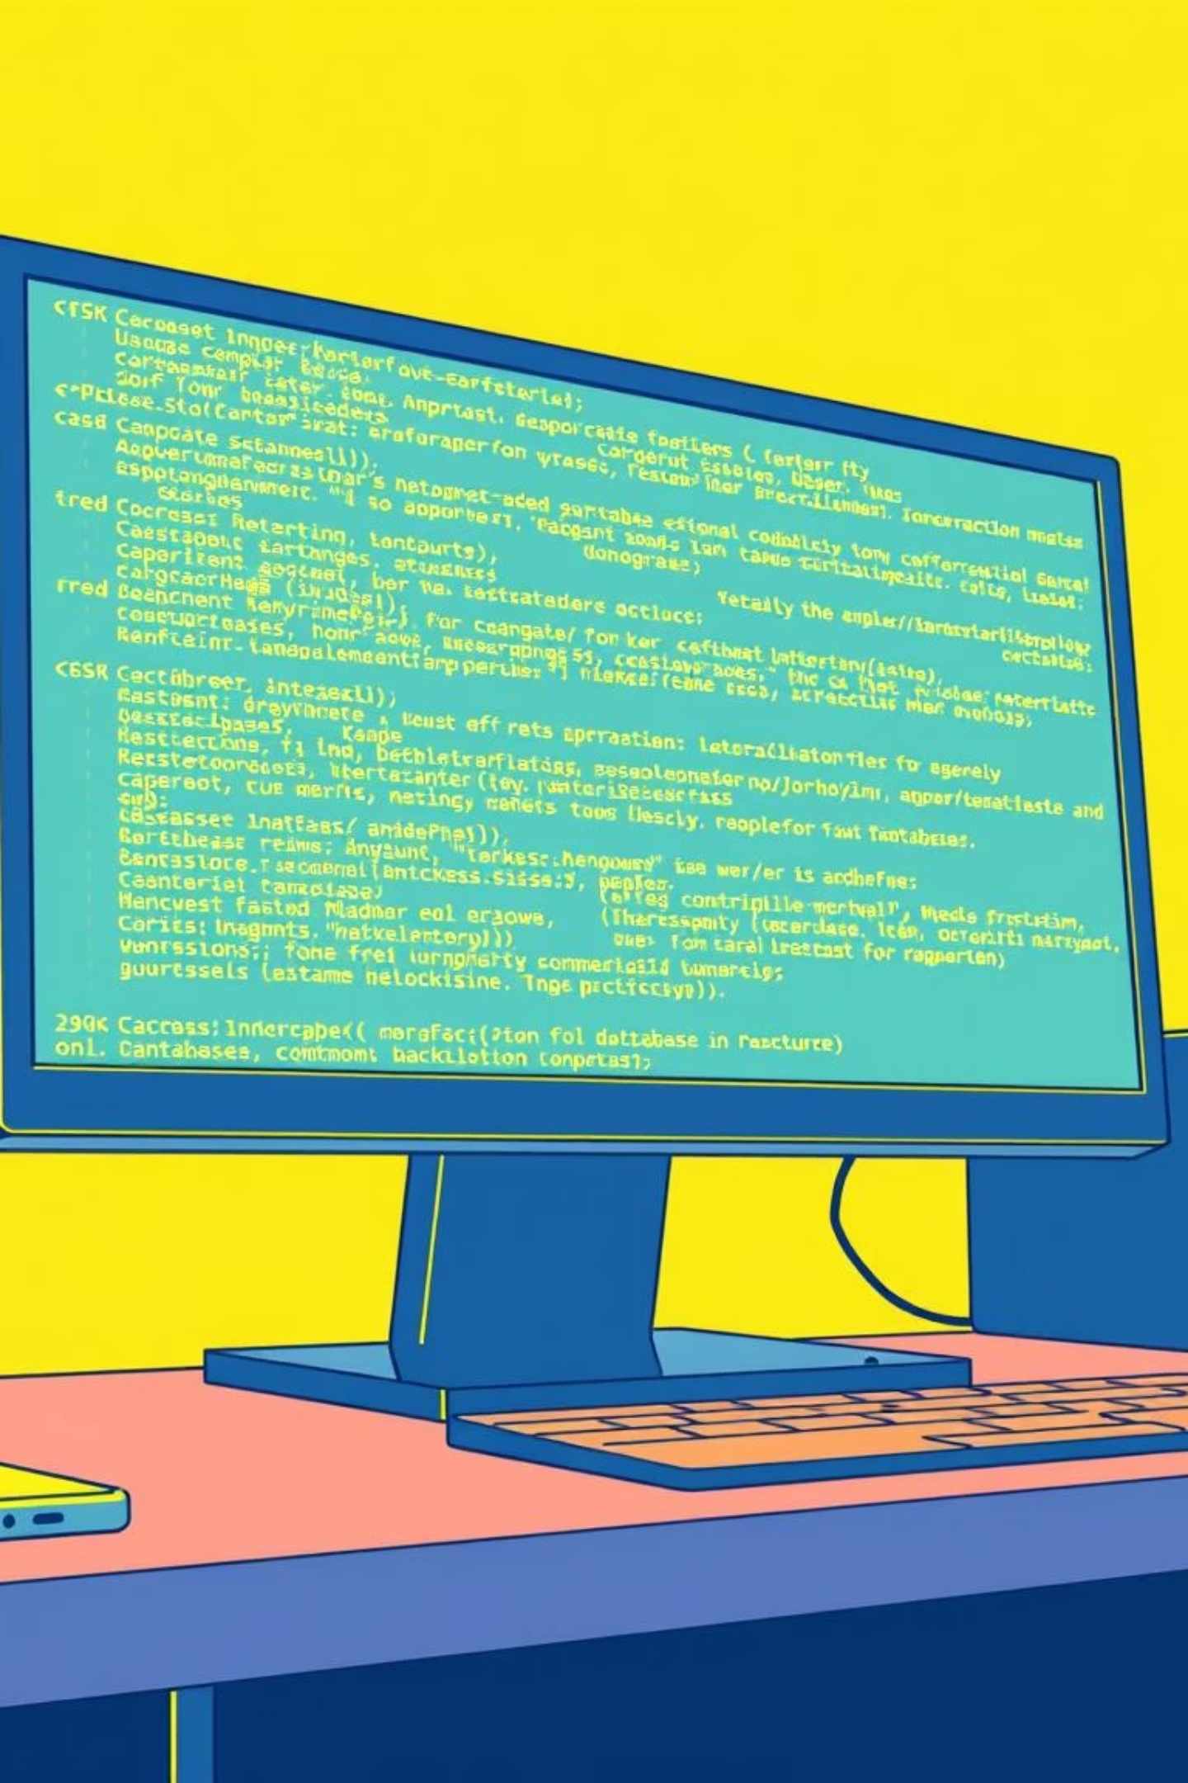
PL/SQL Components: The Engine of Security
Triggers
Verify doctor licenses, medicine risk, refill rules, and log all sensitive actions.
Procedures
verify_prescription, check_refill_request, and insert_fraud_alert for comprehensive checks.
Functions
calculate_risk_score based on patient, medicine, and refill history.
Packages
fraud_monitoring_pkg centralizes all detection logic for streamlined management.

Slide 6
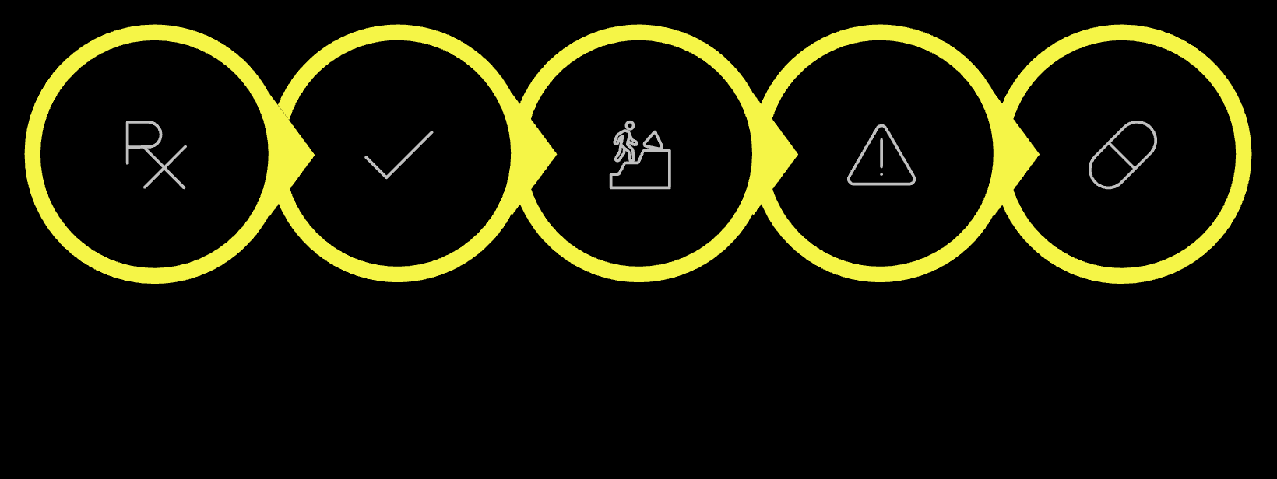
Innovation & Expected Outcomes
System Innovation:
Real-time fraud detection with intelligent risk scoring.
Automated alerts and a robust audit logging system.
Empowers data-driven decision-making for healthcare administrators and regulators.
Prescription
Verification
Risk Score
Alert
Dispense
Key Expected Outcomes:
Significant reduction in prescription fraud.
Accelerated and automated verification processes.
Enhanced patient safety and medication compliance.
Provision of reliable data for critical decision-making.

Slide 7
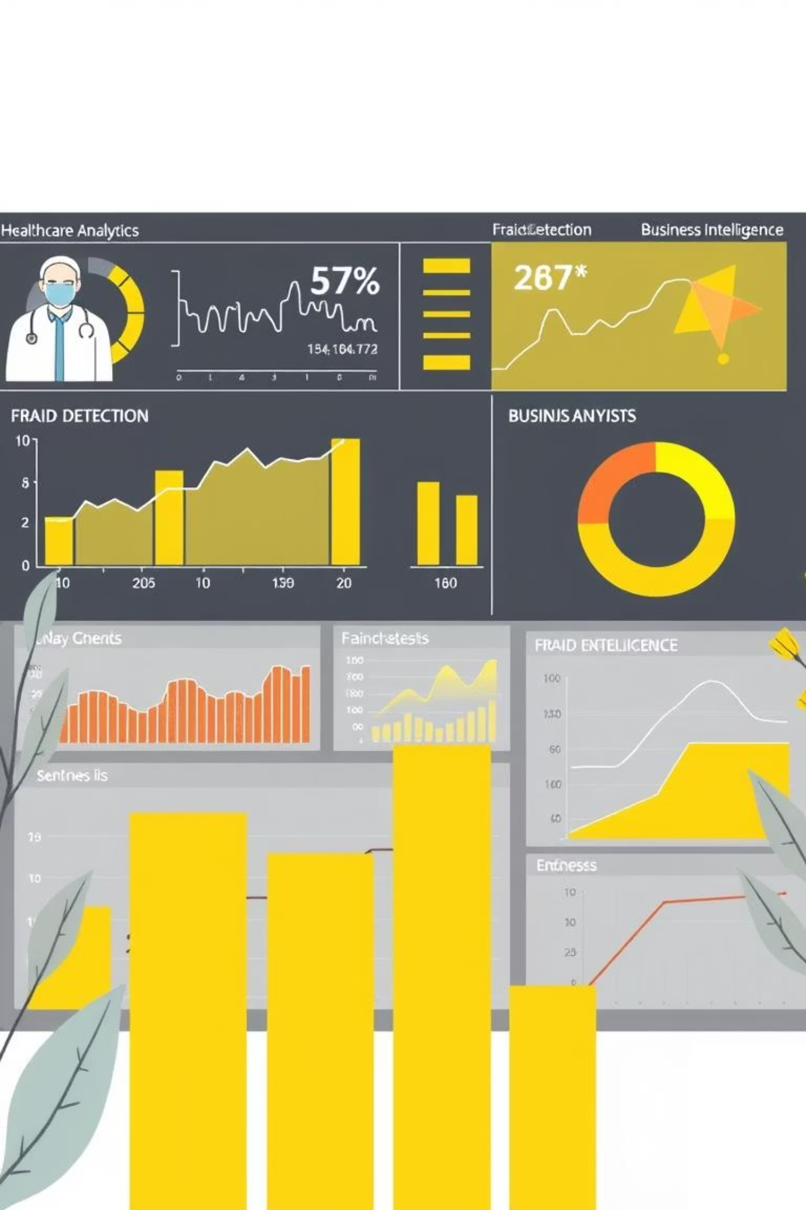

Maximizing Impact with Business Intelligence
Monitor Fraud Patterns
Visualize trends over time, identify emerging threats, and adapt prevention strategies.
High-Risk Identification
Pinpoint specific high-risk medicines, suspicious patients, and unusual doctor activity.
Performance Analytics
Evaluate doctor authorization compliance and overall system effectiveness through comprehensive reporting.
Predictive Alerts
Implement advanced analytics for early warning signals and proactive preventive measures.

